Slide 1

2 PETER

Slide 2
2 PETER
Approximate time of Paul’s appearance before Nero
2 Peter written sometime between AD66-67
AD60
AD62
AD64
AD66
1 Peter written sometime between AD62-64
July 19, AD64 Neronian fire begins

Slide 3
2 PETER
Knowledge ~ ginōskō – 16x in 3 chapters

Slide 4
2 PETER
Precious ~ 8x in 1 and 2 Peter

Slide 5
2 PETER
For all that is in the world—the lust of the flesh, the lust of the eyes, and the pride of life—is not of the Father but is of the
world.
Lust of the flesh ~ controlled by passion
Lust of the eyes ~ controlled by materialism
Pride of life ~ controlled by ambition
1 John 2.16

Slide 6
2 PETER
Add ~ epichorēgeō ~ epi (upon) + chorēgeō (cognate: chorus)

Slide 7
2 PETER
Most assuredly, I say to you, when you were younger, you girded yourself and walked where you wished; but when you
are old, you will stretch
out your hands, and another
will gird you and carry you
where you do not wish.
John 21.18

Slide 8
2 PETER
Deceptive ~ plastos – molded, formed

Slide 9
2 PETER
Hell – tartaroō

Slide 10
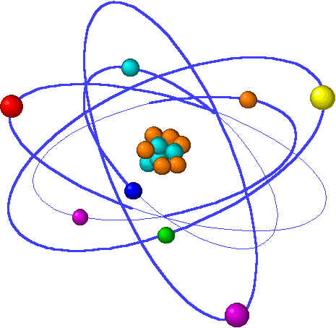
2 PETER
- Electrons
Neucleus
+ Protons
Neutrons

